Slide 1

GenAI App - AI Code Reviewer
Prepared by
Lingerkar Rithikha

Slide 2
Objective
The objective of this project is to develop a Python application that allows users to submit their Python code for review and receive feedback on potential bugs along with suggestions for fixes. The application should be user-friendly, efficient, and provide accurate bug reports and fixed code snippets.
User Interface
The application should have a clean and intuitive user interface built using Streamlit.
Users should be able to easily input their Python code into the application.
Code Review Functionality
Utilize the OpenAI API for code review functionality.
The application should analyze the submitted code and identify potential bugs, errors, or areas of improvement.
The application should also provide the fixed code snippets.

Slide 3
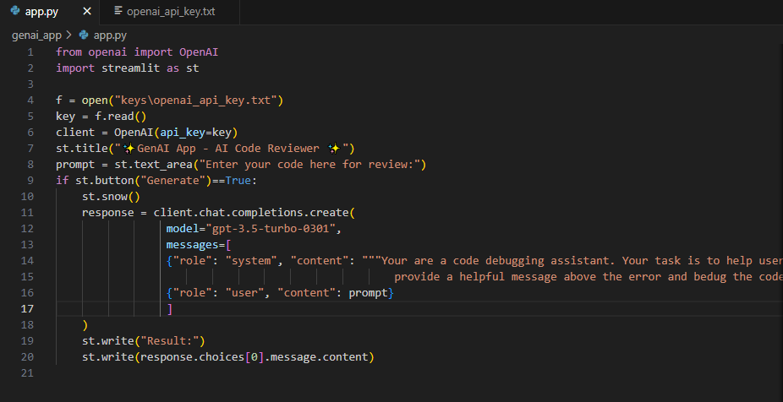
app.py
Streamlit is a free and open-source framework to rapidly build and share beautiful machine learning and data science web apps. It is a Python-based library specifically designed for machine learning engineers. Data scientists or machine learning engineers are not web developers and they're not interested in spending weeks learning to use these frameworks to build web apps. Instead, they want a tool that is easier to learn and to use, as long as it can display data and collect needed parameters for modeling. Streamlit allows you to create a stunning-looking application with only a few lines of code.

Slide 4

Running the app.py using streamlit

Slide 5

THANK YOU

